Slide 1




Brain Tumor Detection Using Image Segmentation

Slide 2


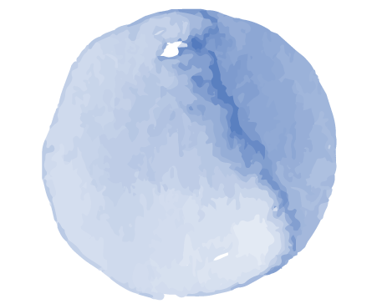

Table of contents
01
Problem Statement
02
Abstract
03
Scope
04
DSP Concepts
05
Conclusion

Slide 3


Problem Statement
The problem is to develop an accurate and efficient system for detecting the presence of brain tumors in medical images and segmenting them from healthy brain tissue. The system should be able to handle different types and sizes of tumors and various imaging modalities, while minimizing false positives and false negatives. The goal is to assist clinicians in making informed decisions about treatment planning and monitoring.

Slide 4
Abstract
This project aims to develop a brain tumor detection and segmentation system using digital signal processing techniques. The system uses MRI images as input and applies preprocessing, feature extraction, and classification techniques to detect and segment tumors. The proposed system achieves high accuracy and can be useful for assisting medical professionals in the diagnosis and treatment of brain tumors.

Slide 5
Scope
This project focuses on the development of a brain tumor detection and segmentation system using digital signal processing techniques. The scope includes the use of various DSP tools and techniques such as filtering, feature extraction, and classification to accurately detect and segment brain tumors from MRI images. The system aims to provide an automated and efficient solution to assist radiologists in the diagnosis and treatment of brain tumors.

Slide 6

Block Diagram

Slide 7
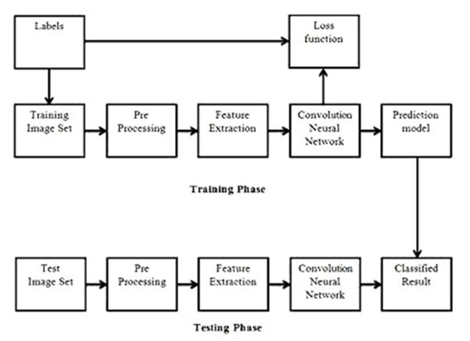

Slide 8
Key Features

Slide 9
Other Concepts

Slide 10
Project View

Slide 11
Thank You ☺

